Slide 1

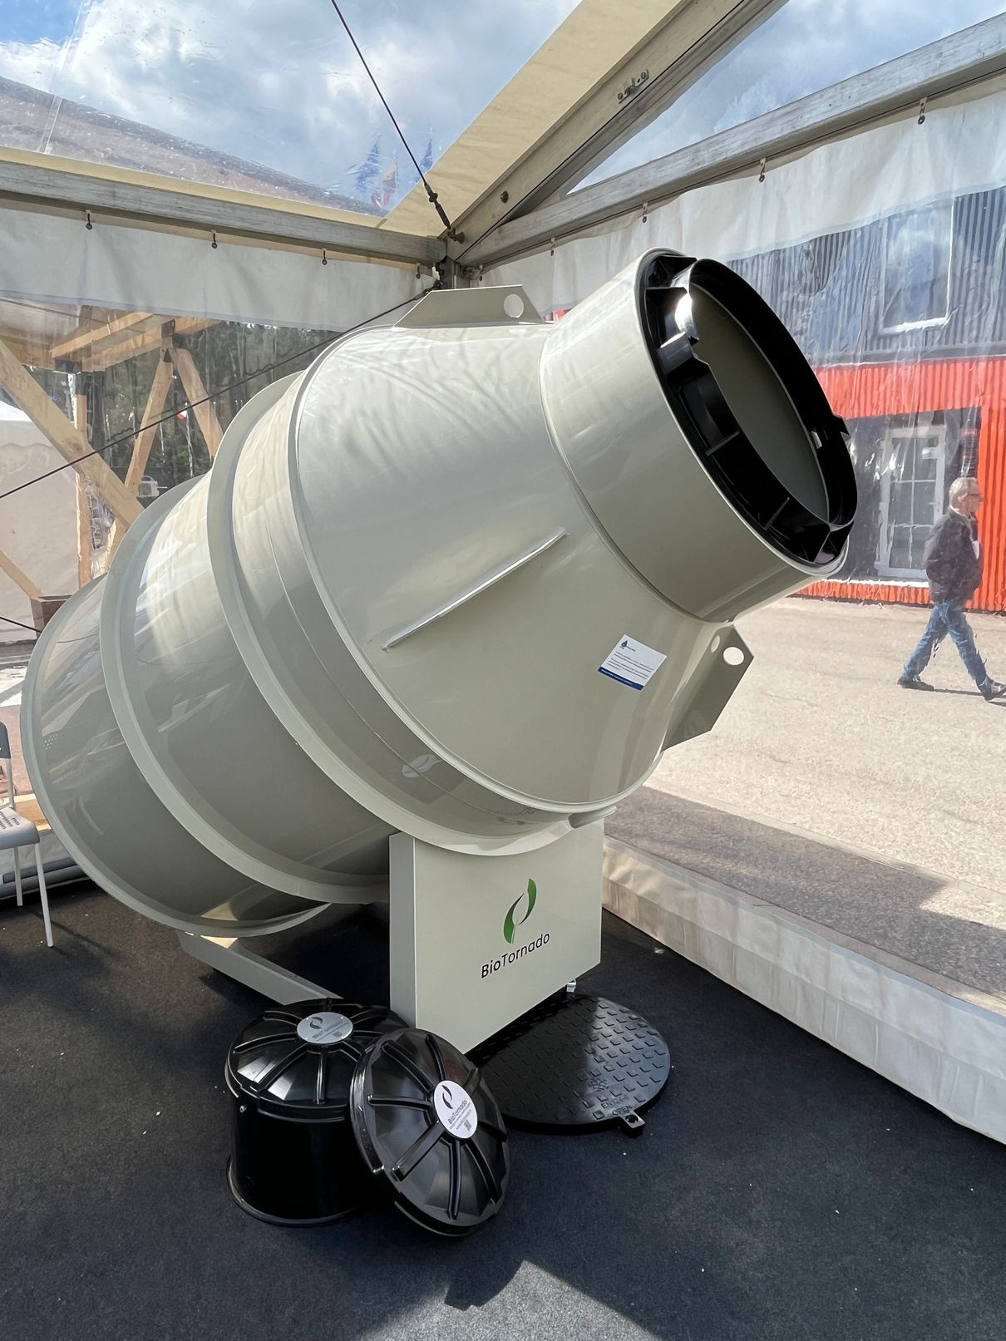


BIOLOGICAL DOMESTIC
WASTEWATER TREATMENT PLANT

Slide 2

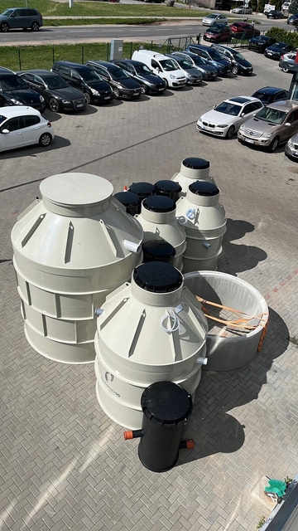
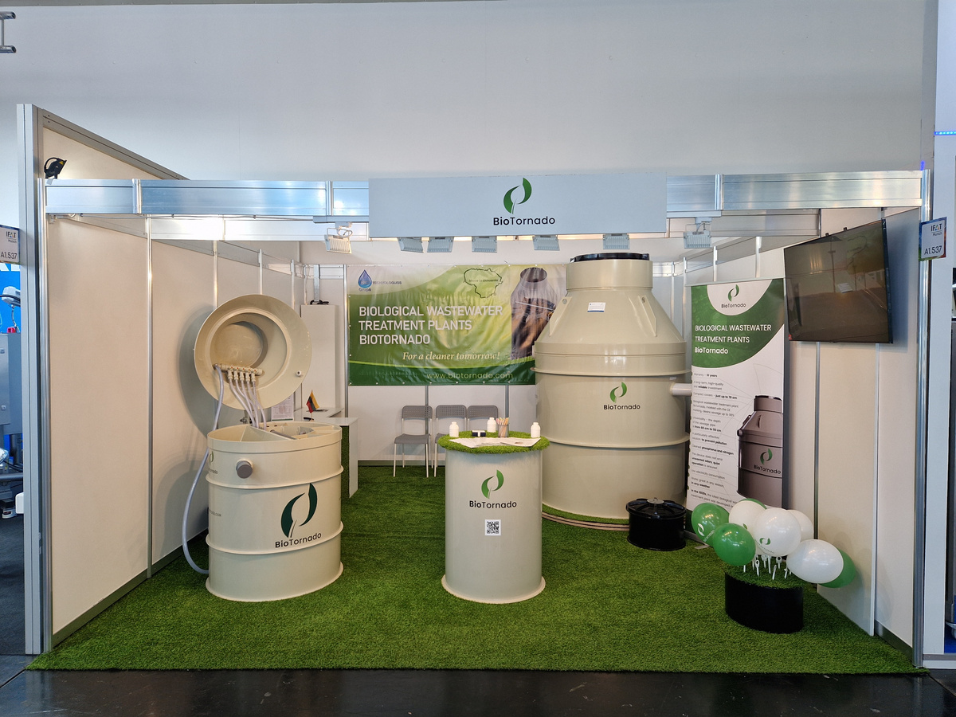
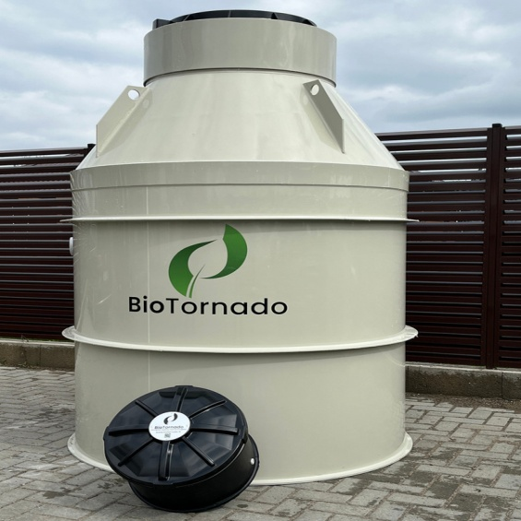
Description
  BioTornado revolutionizes wastewater management with its advanced technology, catering to both small homes and larger complexes for up to 50 people.
  Unique in Europe, it features 8 specialized cleaning chambers, ensuring efficient and cost-effective treatment.
  With an easy-to-install design, compliance with Scandinavian regulations, and a 98% operational efficiency, BioTornado stands out for its performance, reliability, and environmental friendliness.

Slide 3

Core Benefits
Top performing wastewater treatment Technology in the entire EU
BioTornado meets and exceeds the existing treatment requirements of EU standards.
BioTornado offers a 10-year warranty with the highest performance, ensuring it will last for decades! It is EU certified and CE marked.
01
05
The highest category of plastic is used in production, ensuring the best quality and long term durability.
We believe in the sustainable use of resources and have successfully incorporated the concept of 100% plastic reuse in our manufacturing process.
02
06
BioTornado is suitable for all soil types. Our units B4S - B6S are ideal for areas with high groundwater levels.
We offer a wide range of BioTornado products catering to capacities from 4 to 50 residents.
03
07
The unique mechanism of the
8-Compartment BioTornado ensures the highest efficiency.
The payout remains the same, with no increase.
04
08

Slide 4
Extra Benefits
Widely proven by certifications
Odorless working.
Invisible on the site.
Compact and easy to install.
One day installation process.
The depth of the sewage pipe ranges from 60 to 110 centimeters.
01
Mow the lawn perfectly without worrying about protrusion.
05
Delivering fast services throughout European Union.
Quiet working.
02
The cover has a diameter of only
65 centimeters.
Save 50% of electricity with specialized energy saving blowers and pumps.
06
BioTornado is made of high-quality, environment- and human-friendly, environmental-resistant materials.
Effective solution to prevent water pollution.
03
Work in all weathers Conditions with same performance.
07
Made in Lithuania, directly from the factory.
The unique mechanism of the
8-Compartment BioTornado ensures the highest efficiency.
High production standards.
04
Excellent solution for those who is unable to connect with centralized wastewater treatment system
08

Slide 5










Comparison
Example
Septic
Example
BioTornado
Use of recycled water
Discharge to rivers/lakes
Use for lawn watering
Watering plants and flowers

Slide 6



Comparison
Septic
Wastewater facility
BioTornado
BioTornado
Performance
25%
94%
98%
Nitrogen
irremovable
26.4mg/L
16.3mg/L
Phosphorus
irremovable
6.79mg/L
1.56mg/L
Service
2-6 in year
2-3 time in year
1 time in year
Pollution of the environment
75%
6%
2%
Secondary use
not allowed
allowed
allowed
Cover size
1m-1.5m
0.7m-1.5m
0.65m
Number of working cameras
1-2
2-6
8
Operation of the air supply unit
24h/a day
24h/a day
12h/a day

Slide 7
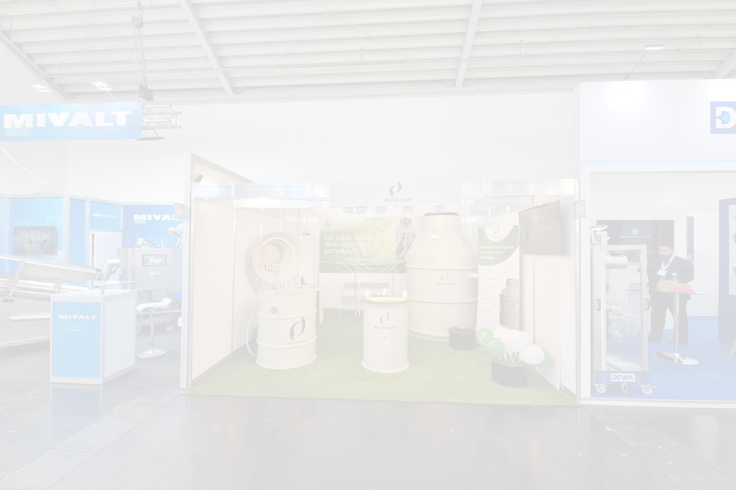
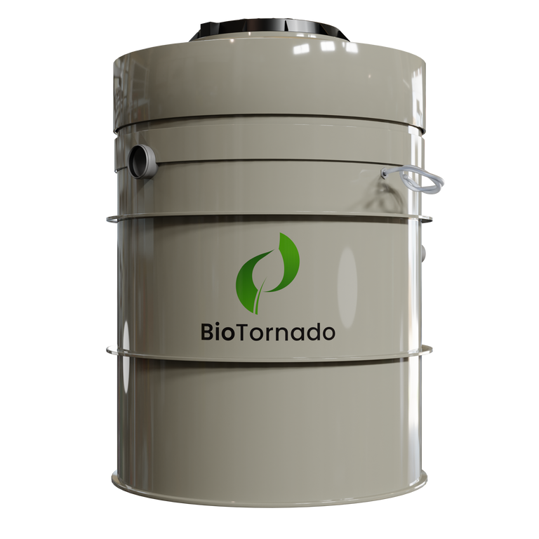
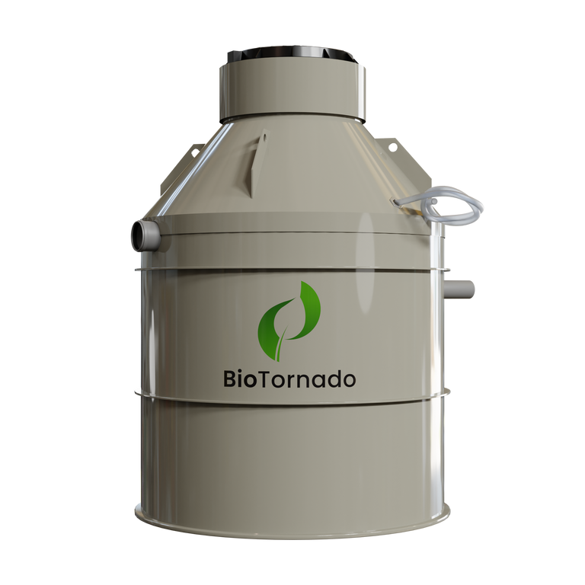
Product Features
Model
People
Capacity
Weight
B4S - B65
2-6
0.6–0.9 m³/day
150-165
B4A-B10A
4-10
0.6–1.5 m³/day
150-240
B15A-B50A
15 – 50
2.25–7.5 m³/day
300-540
Materials High quality Polypropylene (PP)

Slide 8
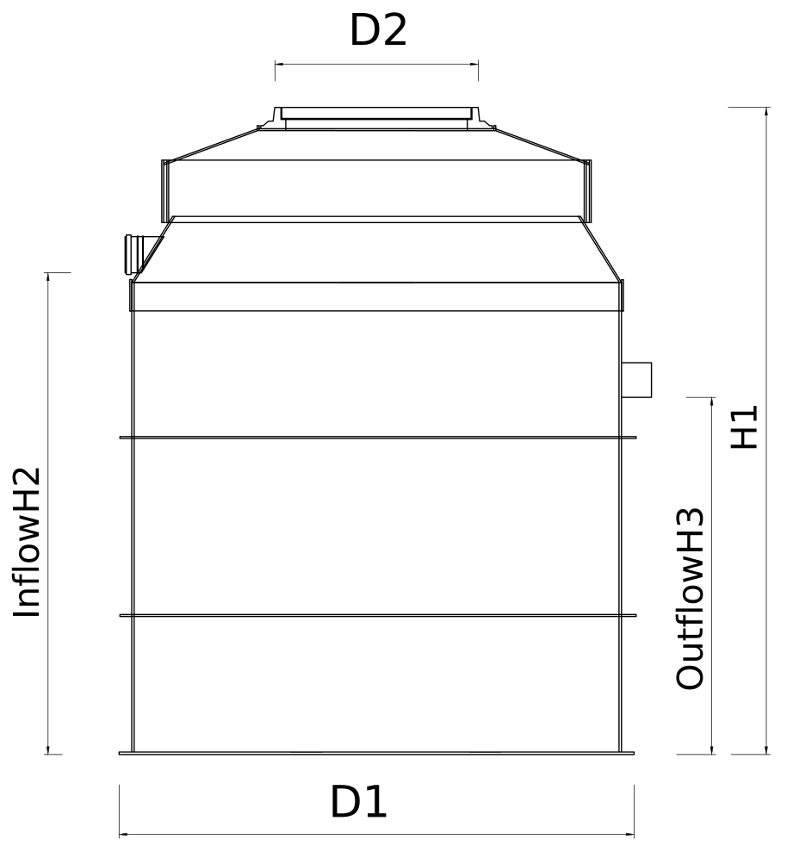
Product Features
B4S-B6S
Capacity: Suitable for homes with 2-4 people, offering a treatment capacity of 0.6 m³/day.
01
Easy Installation: Designed for user-friendly installation, ensuring a hassle-free setup process.
02
Low Maintenance: Simple maintenance procedures for convenience and longevity.
03
Inflow H2
Outflow H3
Efficient Treatment: Provides effective wastewater treatment for smaller households.
04
Septic
Compact Design: Space-efficient design to fit seamlessly into residential areas.
05

Slide 9
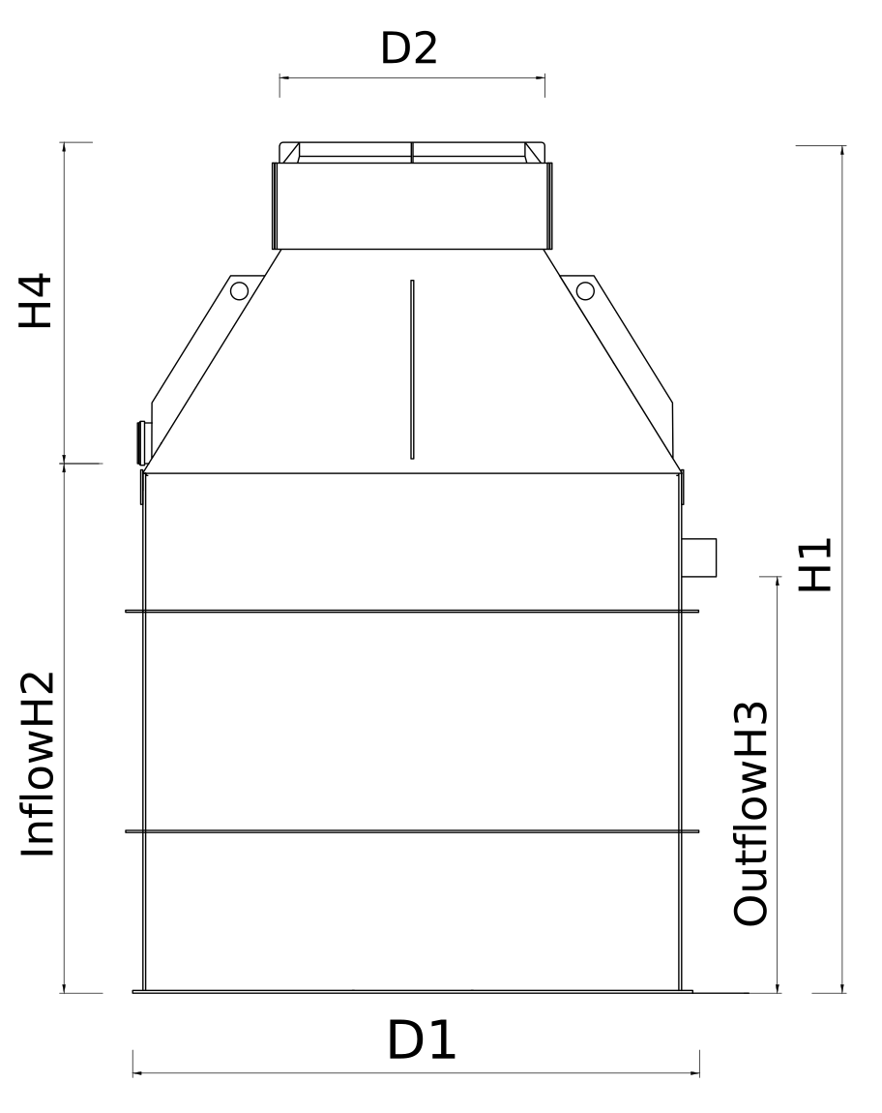
Product Features
B4A-B10A
Capacity: Ideal for medium-sized residences accommodating 4–10 people, with a treatment capacity of 0.6 – 1.5 m³/day.
01
Easy Installation: User-friendly installation process for quick and efficient setup
Example
02
Septic
Low Maintenance: Designed for easy maintenance to ensure longevity and optimal performance.
03
Inflow H2
Efficient Treatment: Offers effective wastewater treatment for larger households.
04
Example
Outflow H3
Septic
Compact Design: Blends seamlessly into medium-sized residential environments.
05

Slide 10
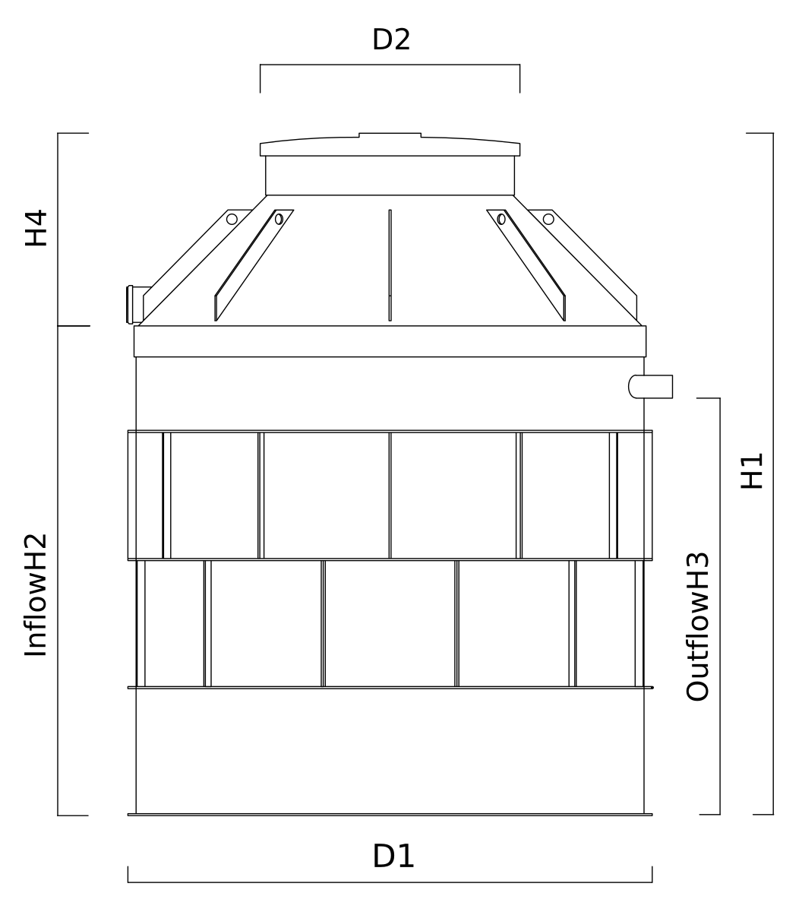
Product Features
B15A-B50A
Capacity: Tailored for commercial buildings accommodating 15–50 people, with a treatment capacity of 2.25 – 7.5 m³/day.
01
Easy Installation: Engineered for easy installation, reducing downtime for commercial spaces.
Example
02
BioTornado
Septic
Example
Low Maintenance: Sturdy design with simplified maintenance processes for commercial-grade durability.
03
Inflow H2
Efficient Treatment: Capable of efficiently treating larger volumes of wastewater for commercial use..
Outflow H3
Example
BioTornado
04
Septic
Compact Design: Designed to meet the demands of commercial spaces while maintaining a professional appearance.
05

Slide 11
Performance results
Effluent (%)
Effluent (mg/L)
BDS5
97.6
8.41
ChDS
94.5
37.8
SM
97.5
8.81
SS
97.5
8.81
Nkj
87.6
10.3
Ntot
80.1
16.3
Nb
80.1
16.3
Inflow H2
Outflow H3
Pb
80.8
1.56
NH4N
89.6
8.4
NO2N
-
0.381
NO3N
-
5.64

Slide 12

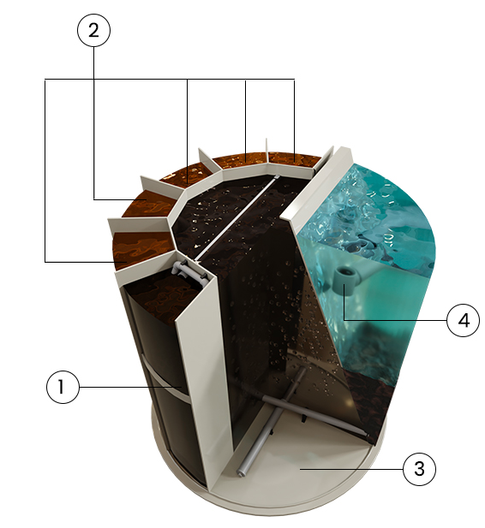
How does it work?
2. Anoxic Zone
Here, the simplified organic matter undergoes denitrification, where nitrate and nitrite are converted into nitrogen gas. This process effectively reduces the nitrogen content in household wastewater.
1. Anaerobic
Wastewater enters BioTornado through the inlet and passes through a mechanical grate, ensuring that large particles and grit do not hinder the treatment process or cause mechanical maintenance issues. In the anaerobic zone, complex organic matter is broken down into simpler forms in preparation for the next stage of treatment, all in the absence of air.
4. Clarification Zone / Settlement Zone
The wastewater from the aeration tank flows into the clarification zone, where gravity separates water from sludge. The heavier sludge settles at the bottom and is transferred back to step #01, while the treated water is collected in the next compartment. This water meets the effluent standards of Scandinavian markets and adheres to strict EU safety, health, and environmental protection requirements. It can be utilized for home gardening purposes or safely discharged into the environment.
3. Aeration Zone
Oxygen is supplied in this chamber, enabling aerobic bacteria to consume and decompose the organic matter in the presence of free oxygen. These bacteria play a crucial role in removing organic matter from the wastewater.

Slide 13
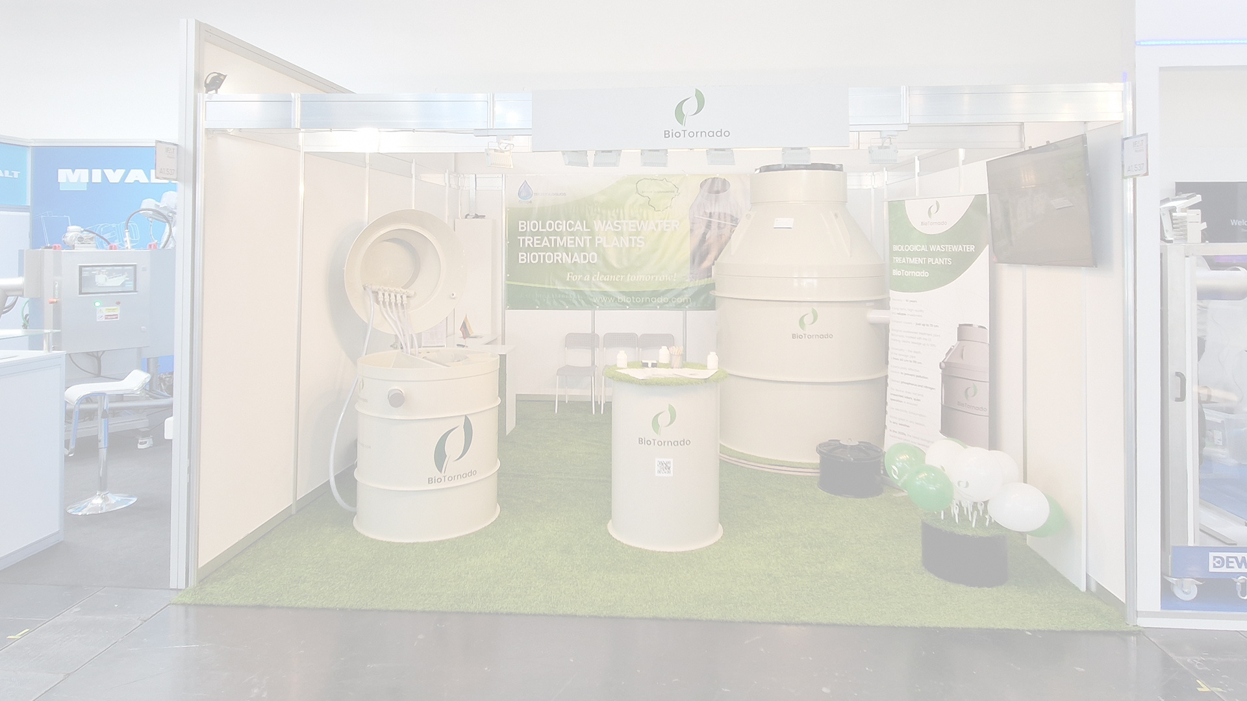

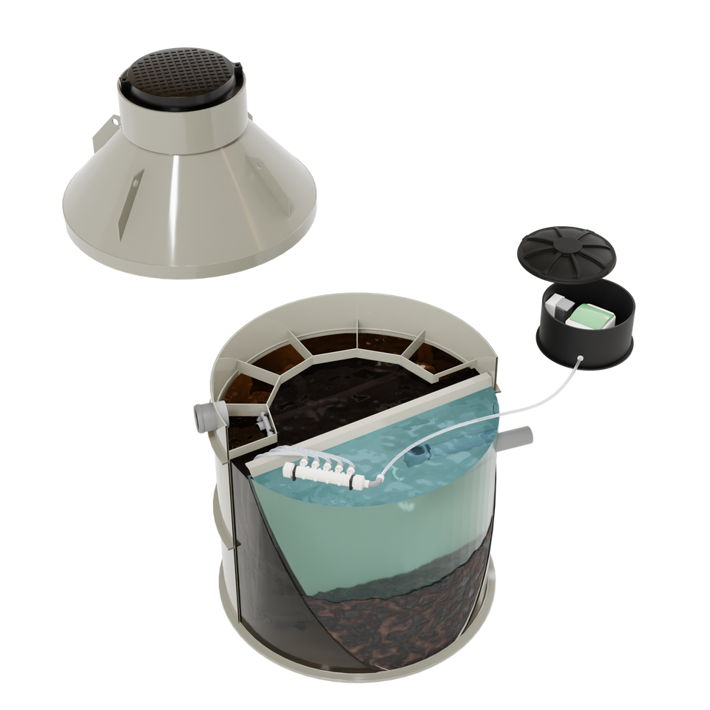
WHAT IS INCLUDED IN THE
BIOTORNADO PACKAGE ?
Sewage treatment facilities are equipped with attractive, compact, light-type covers, which are adjusted to the level of the lawn with the help of a telescope after installing BioTornado.
BioTornado is equipped with long-lasting blowers, which supply air to the equipment not only during the warranty period, but also for a significantly longer period of time. In order for BioTornado to work efficiently, services should be performed less often, it is necessary to dose oxygen, mechanical timers that serve for many years are equipped for this function.

Slide 14





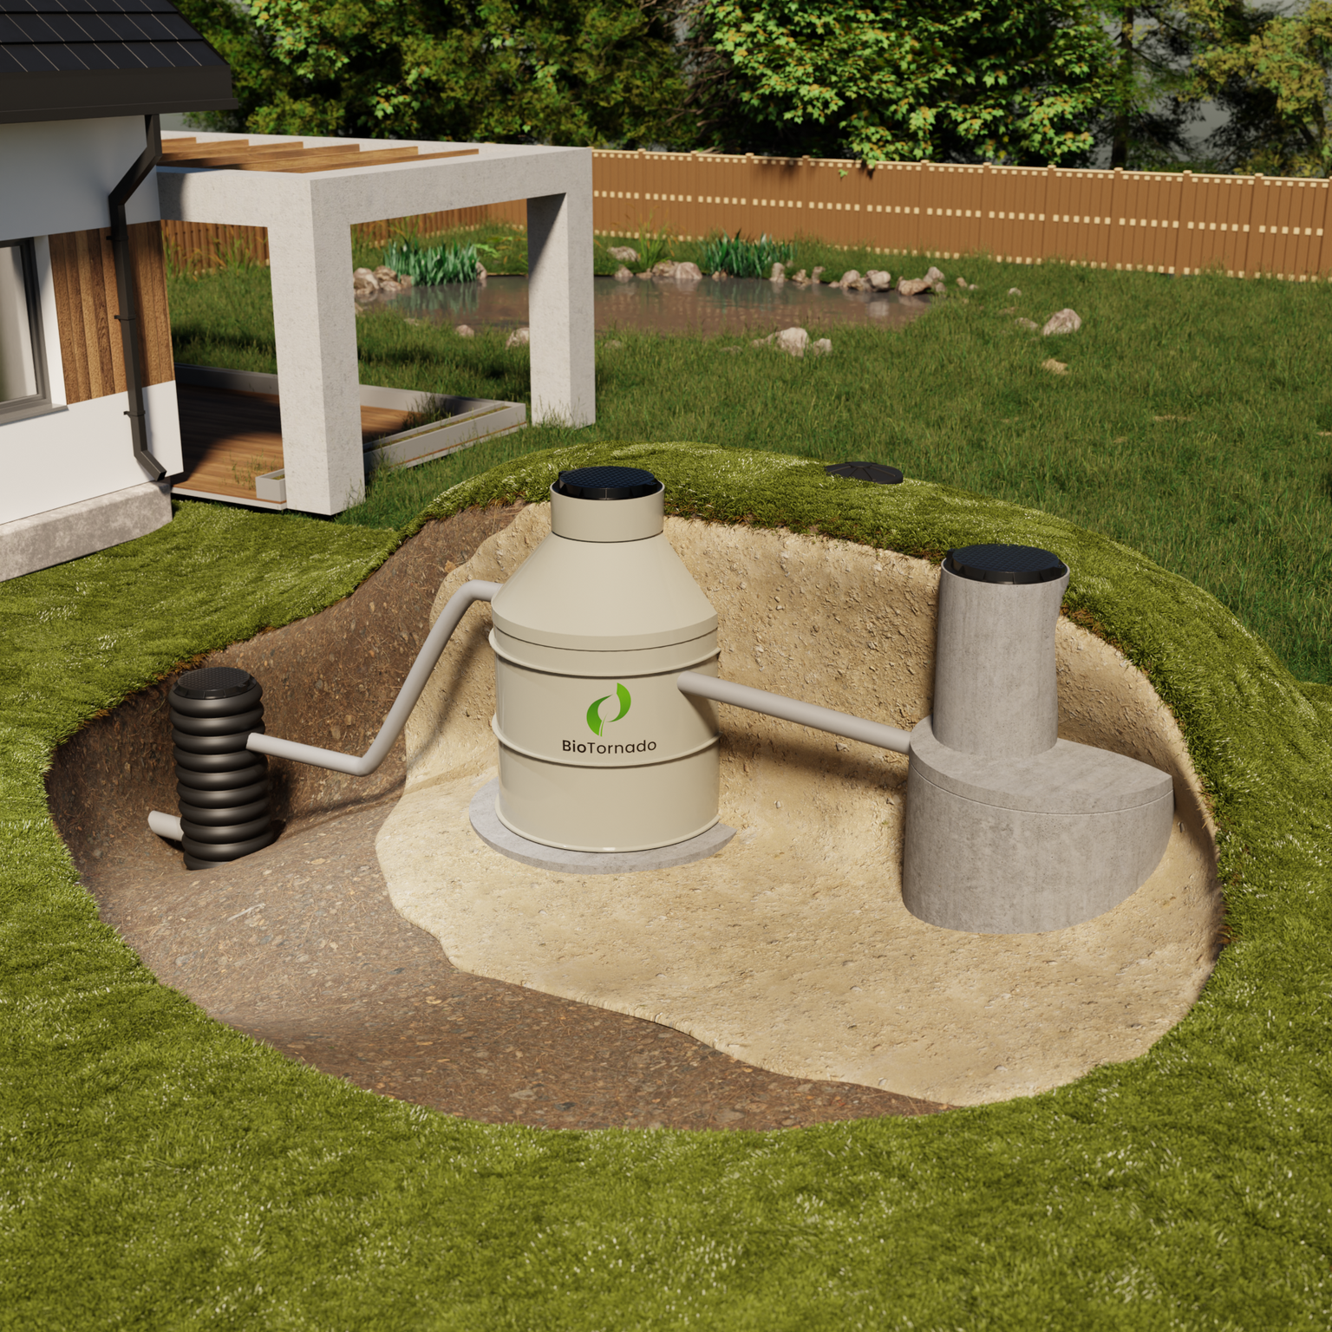
Engineered for All Soil Types
Odorless
working.
Invisible
on the site.
Compact and easy to install.
One day
installation process
01
No matter the soil type—sandy, clay, silt, peat, chalk, loam, or any other—BioTornado delivers exceptional results in all soil conditions.
02
BioTornado, certified equipment, has passed rigorous compression tests, ensuring it can be installed in a variety of soil types.
03
The BioTornado team pays great attention to the quality of assembly, ensuring long-lasting operation.

Slide 15
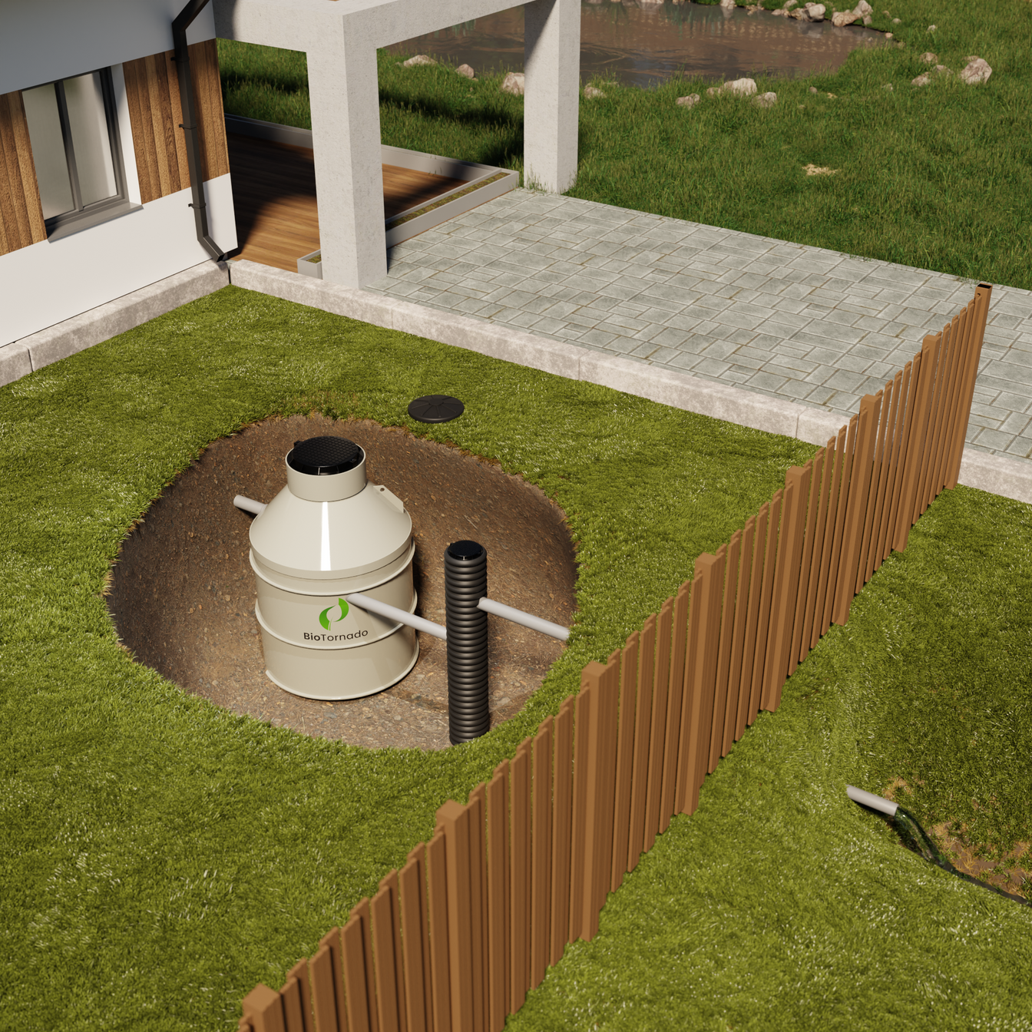
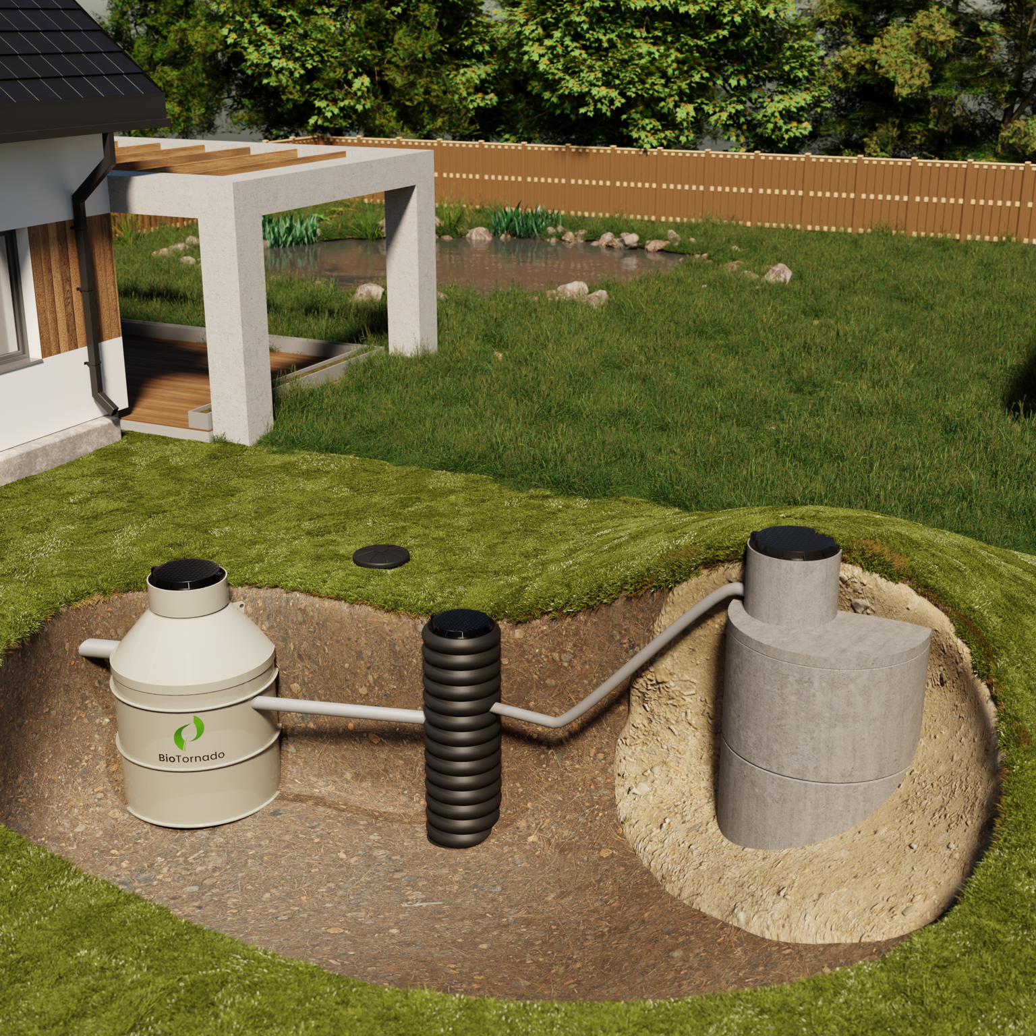

BioTornado model-based specification
01
S model is perfect for installation in soils where high ground water prevails or the depth of the inlet pipe is 50 cm from the ground surface.
02
A model specifically designed for normal soil conditions, requiring no special adaptations, and ready for immediate installation and operation.

Slide 16
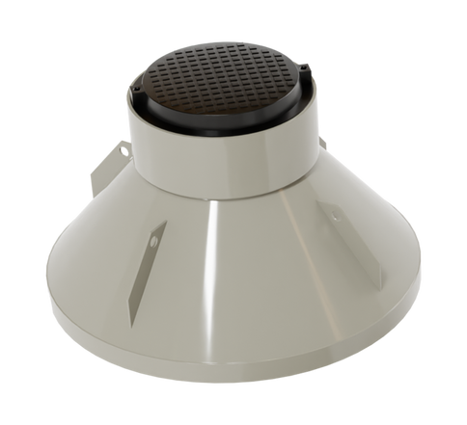
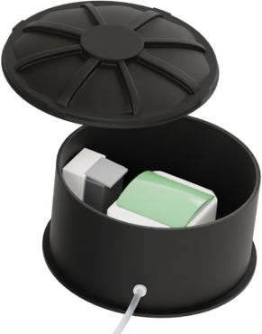
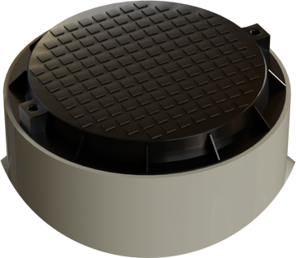
Types of covers
01
Sewage treatment facilities are equipped with attractive, compact, light-type covers
02
BioTornado covers can be adjusted to the level of the lawn with the help of a telescope after installing BioTornado.

Slide 17
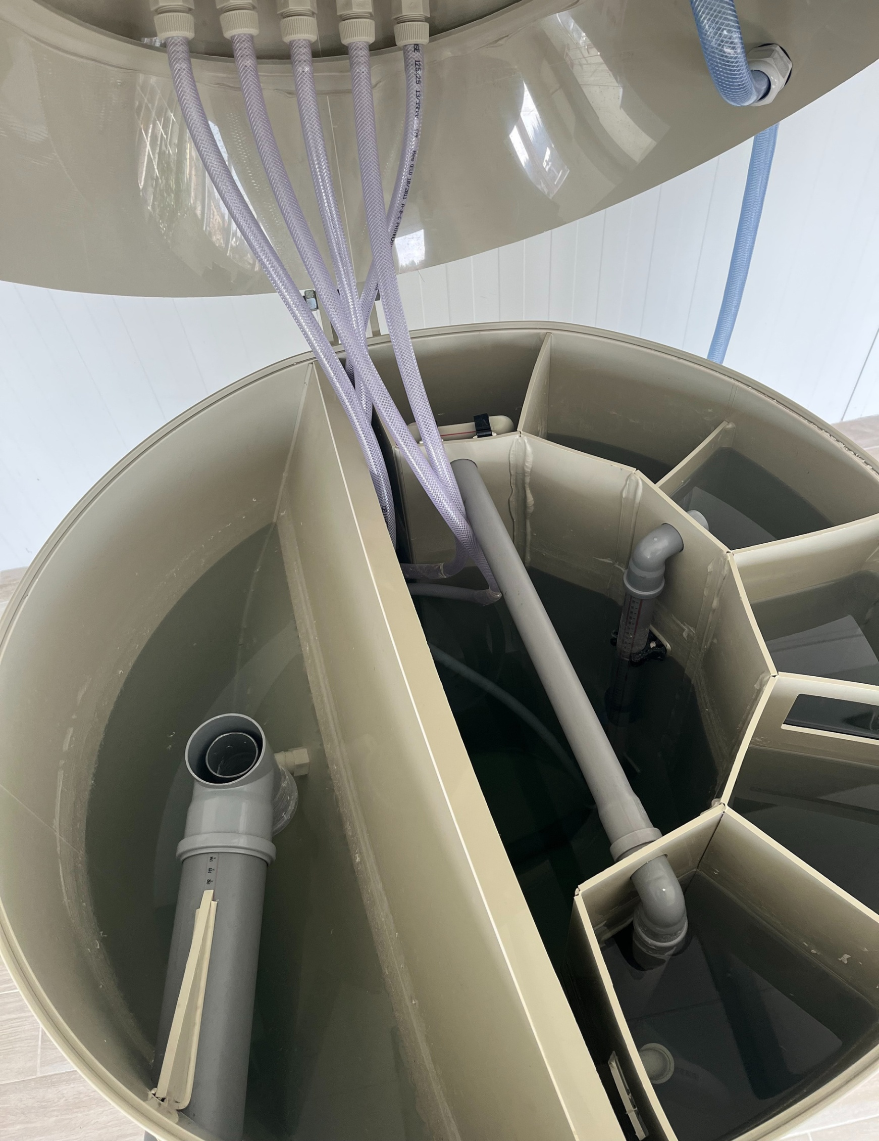

BioTornado Maintenance Requirements
Maintenance once a year
Inspection twice a year

Slide 18

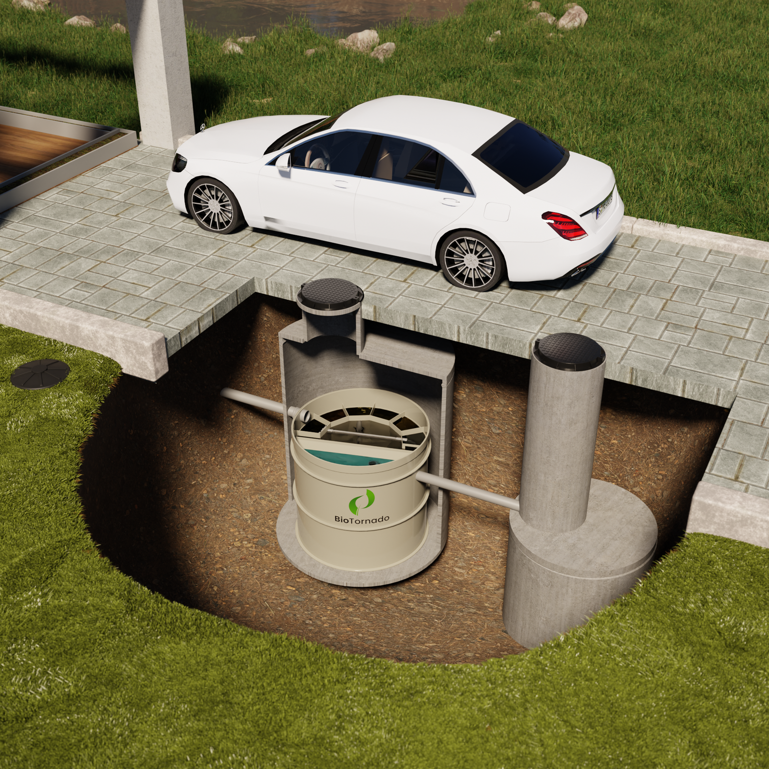

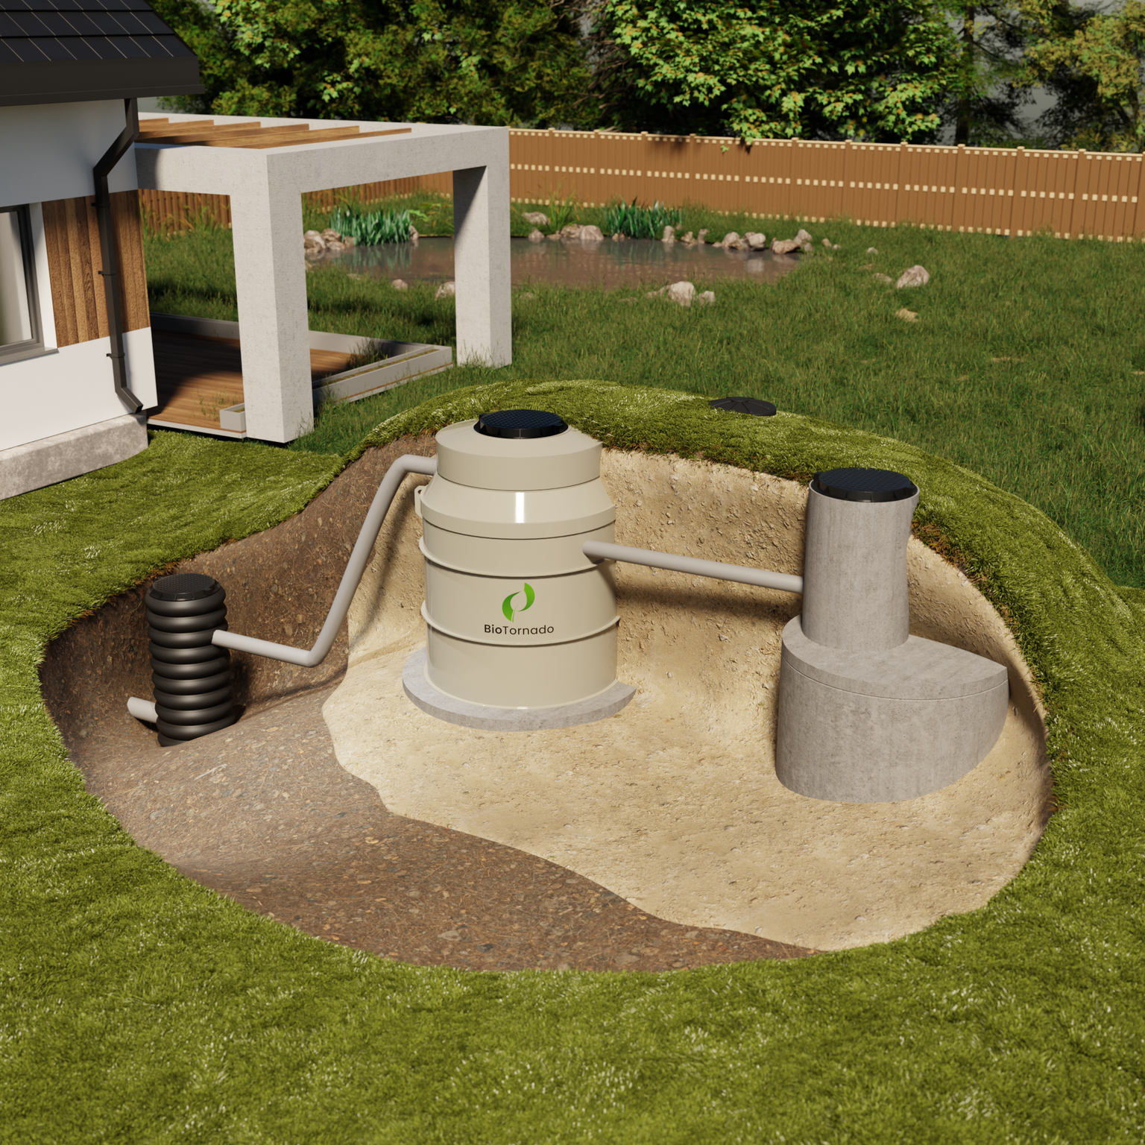
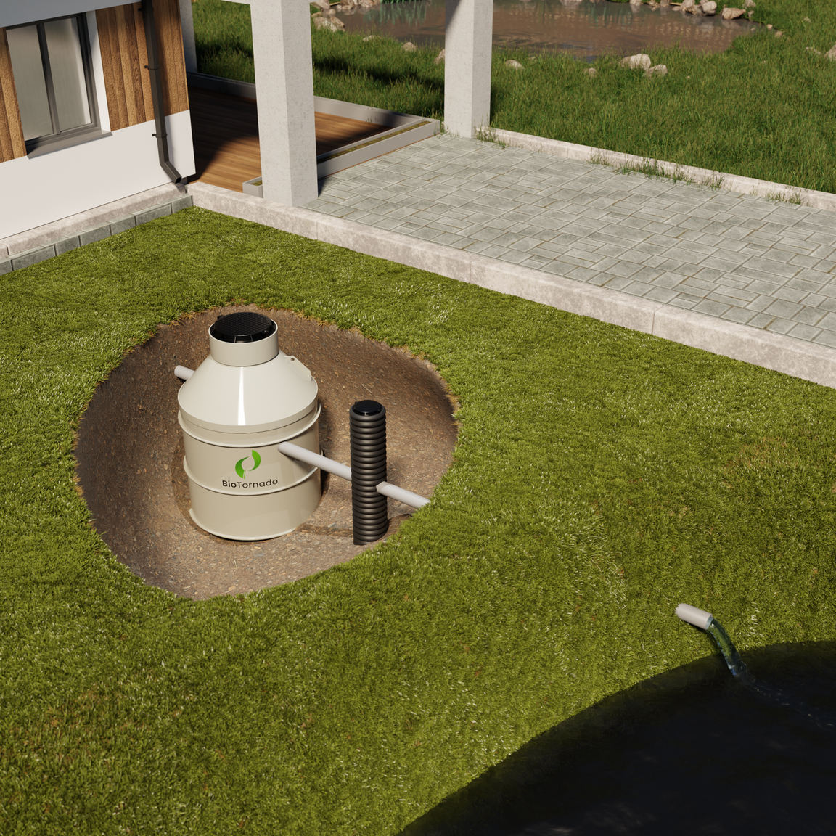
BioTornado Installation

Slide 19
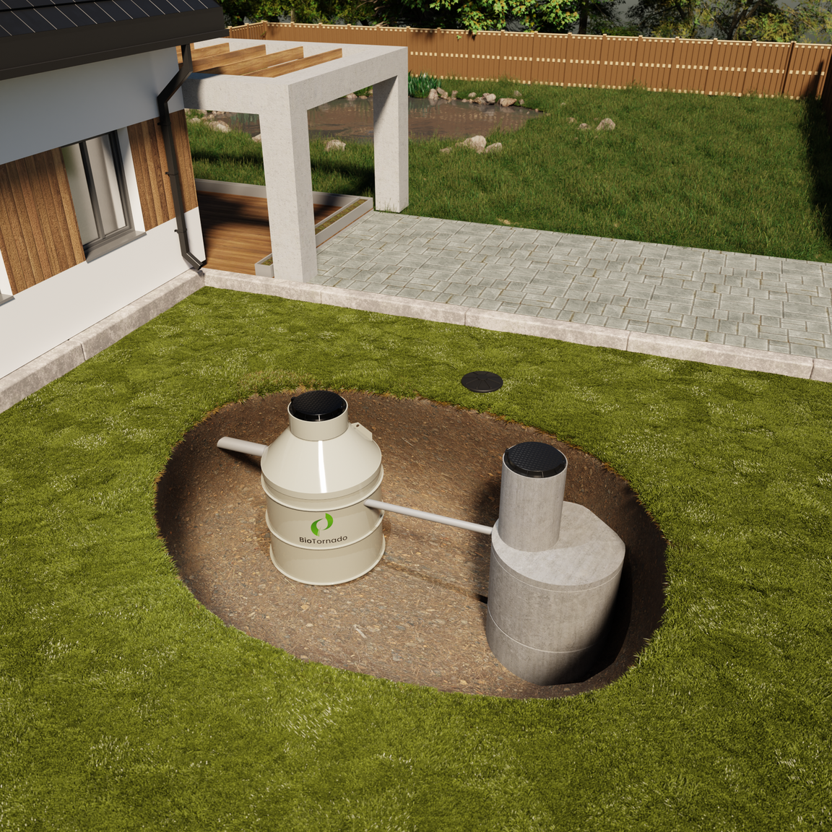
Installation options
01
A reinforced concrete infiltration well is being constructed to help water soak into the ground. The infiltration well consists of two concrete rings, each 1.5 meters in diameter and 1 meter tall. On top of these rings, there is a 0.15-meter layer of gravel with a hole in it. Inside the well, there is a smaller chamber, 0.7 meters in diameter and 1 meter tall, which is covered with a plastic lid. This setup helps direct water into the ground efficiently.
02
A sampling well, made of plastic with a diameter of 0.315 meters, is used to collect water samples for testing before clean water is released into meadows, ditches, or under bushes. The well includes a sealed bottom and a plastic cover to keep it enclosed.

Slide 20
Installation options
03
If effluent leaves a building at a depth greater than 1.15 meters or if digging deeper is impossible due to high groundwater, an effluent pumping station is needed to lift the wastewater to the biological wastewater treatment plant. After treatment, the water flows into infiltration well. The effluent pumping station typically consists of a 0.7-meter wide, 2.2-meter tall plastic tank with an internal pump and a plastic cover.
04
The purified water is directed to a discharge pumping station, which enables the water to be discharged onto meadows, into ditches, or under bushes. This station usually has a plastic tank, about 0.7 meters wide and 2.0 meters high, with a pump inside and a plastic cover.

Slide 21
Installation options
05
When a biological wastewater treatment plant is installed beneath paving stones in the roadway, the equipment is placed inside concrete well rings with a 2.0-meter diameter. To ensure stability and support the entire load, a concrete pad is placed underneath the rings. This setup helps protect the equipment from the weight and movement of vehicles above.
In this setup, the equipment is installed without the upper cone section. The blower is positioned sideways in a nearby meadow. The purified water is then directed into infiltration wells, similar to the first setup. This design helps manage the flow of clean water into the ground efficiently.
Metal covers are used for both the equipment and the infiltration wells. These covers are designed to support heavier loads, but they have a similar appearance to plastic covers, maintaining a clean and consistent look while providing extra strength and durability.

Slide 22

Installation options
06
Clean water is directed to a water pumping station, which lifts the water to an infiltration well. The well is positioned on a mound that rises about 1.0 meter above ground level. Gravel is placed beneath the well to improve water absorption. The setup includes:
  A 1.5-meter diameter well, 1.0 meter in height.
  A 0.15-meter thick concrete or gravel cover with a hole for water flow.
  A smaller well inside, with a 0.7-meter diameter and 0.5 meters in height.
  A plastic cover for the smaller well, designed similarly to the main device.
This system helps efficiently manage the purified water and ensures proper infiltration into the ground.

Slide 23
Dimension
Guide
Model
Diameter
D1, m
Height
H1, m
Inlet
H2, m
Outlet
H3, m
Cover
D2, m
Inlet
Outlet
B4S
1.48
1.95
1.38
1.06
0.07
110
110
B4A
1.48
2.3
1.38
1.06
0.07
110
110
B6S
1.65
2
1.54
1.21
0.07
110
110
B6A
1.65
2.5
1.54
1.21
0.07
110-160
110
B8A
1.78
2.5
1.69
1.37
0.07
110-160
110
Inflow H2
Outflow H3
B10A
1.93
2.7
1.74
1.41
0.07
110-160
110
B15A
2.08
2.95
2.1
1.76
1.26
110-200
110
B20A
2.57
3
2.05
1.71
1.26
110-200
110
B25A
2.54
3.3
2.4
2.06
1.26
110-200
110
B30
2.78
3.2
2.34
2.01
1.26
110-200
110

Slide 24
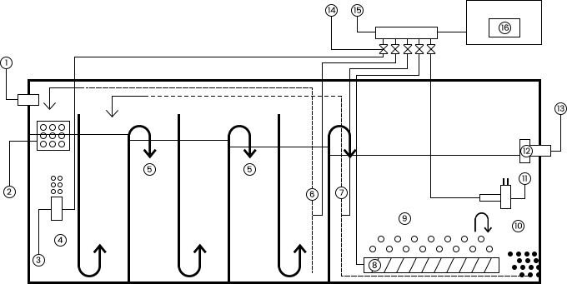
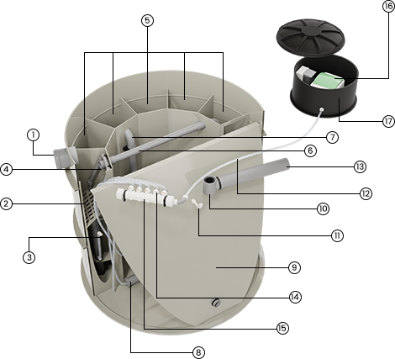
Standard Compartments
TECHNOLOGY
1
Inlet pipe
9
Precipitator area
2
Mechanical grate
10
Air supply to the precipitator area
3
Air supply
11
Outlet water flow regulator
4
Anaerobic area
12
Outlet
5
Anoxic area
13
Air distribution dampers
6
Circulation pipe
14
Air distribution manifold
7
Aeration diffuser
15
Blower
8
Aeration area
16
Blower tank

Slide 25
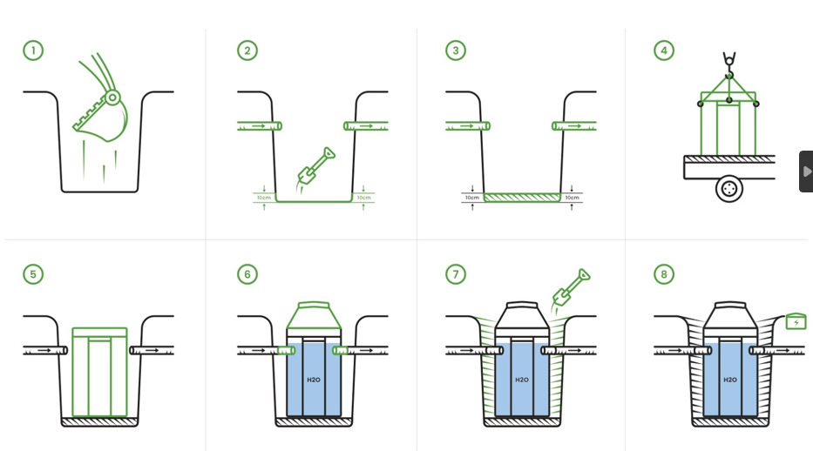
Installation Process

Slide 26
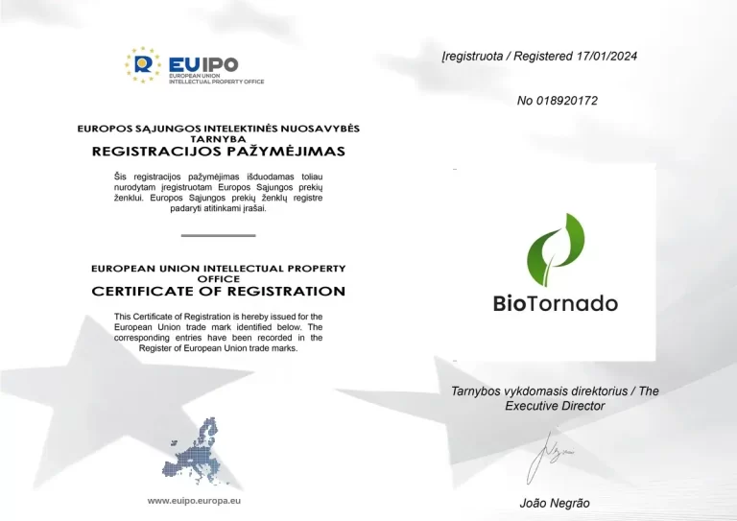
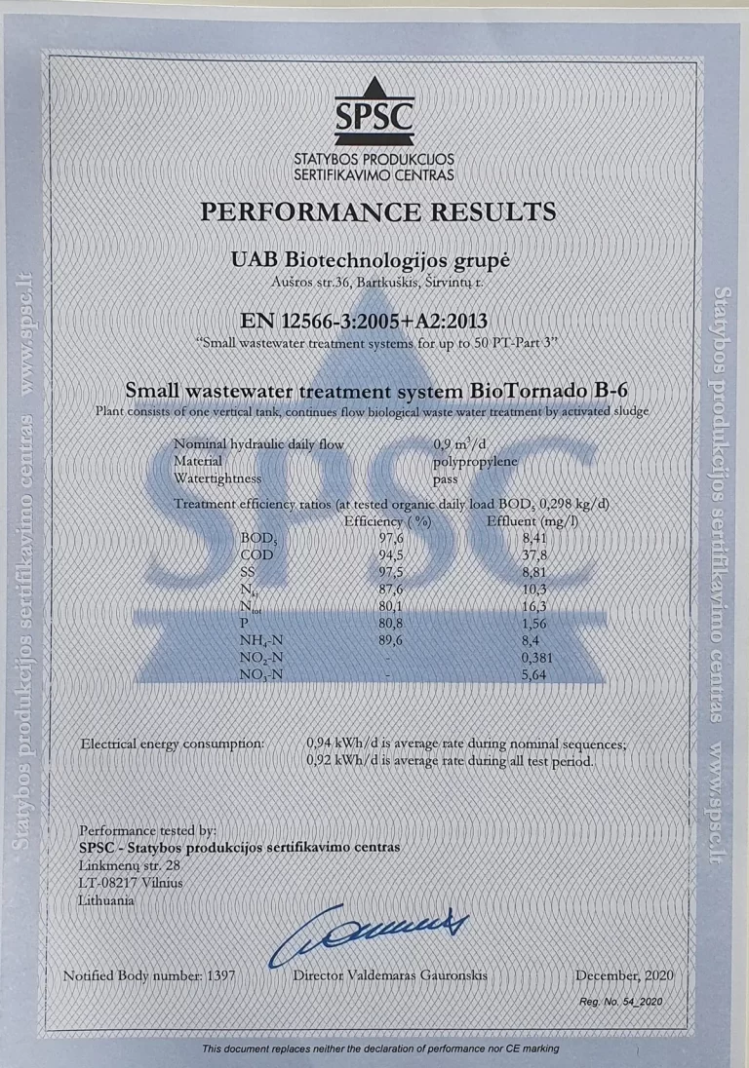
Certificates and Patents
BioTornado
EU patent certificate
BioTornado
Performance results certificate

Slide 27
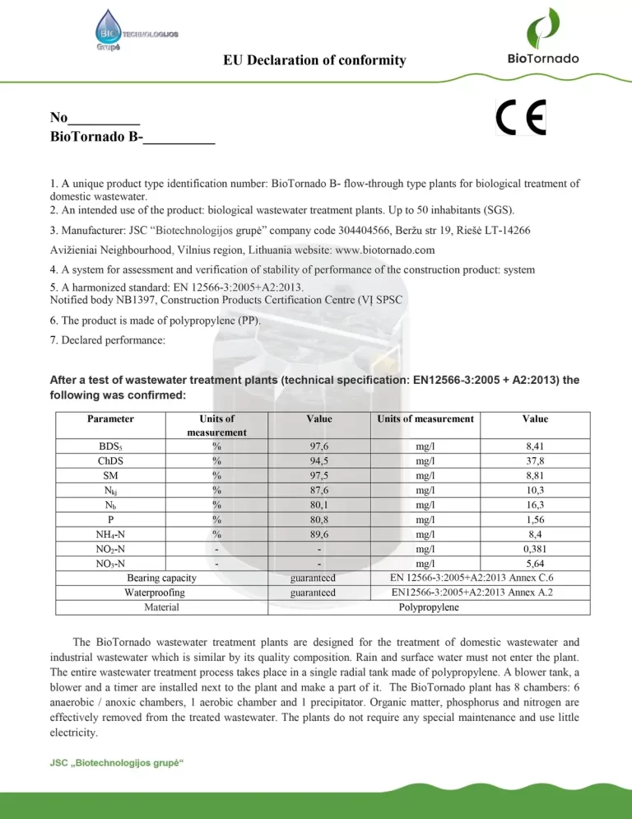
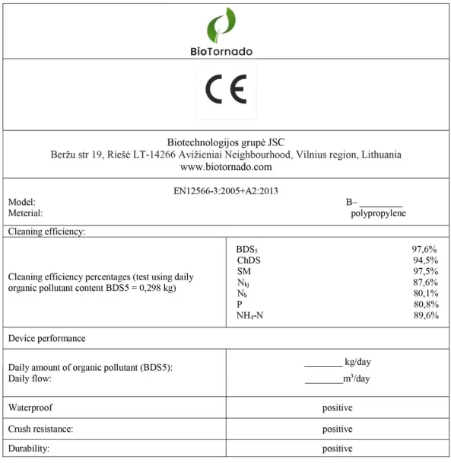
Certificates and Patents
BioTornado
EU declaration of comformity
BioTornado
CE marking certificate

Slide 28
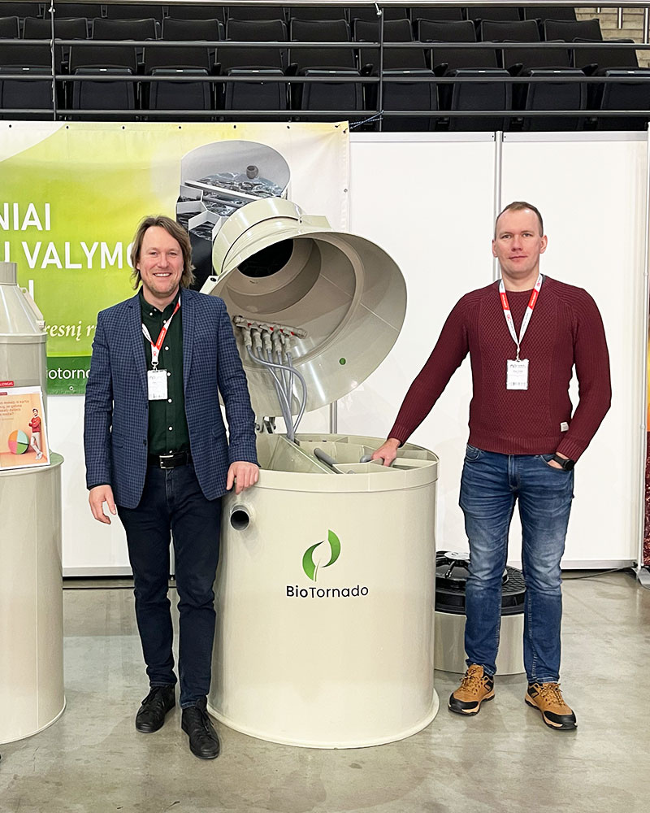



+370 608 27 584 | +370 647 14207
info@biotornado.com
www.biotornado.com
Explore our domestic wastewater solutions

